Slide 1
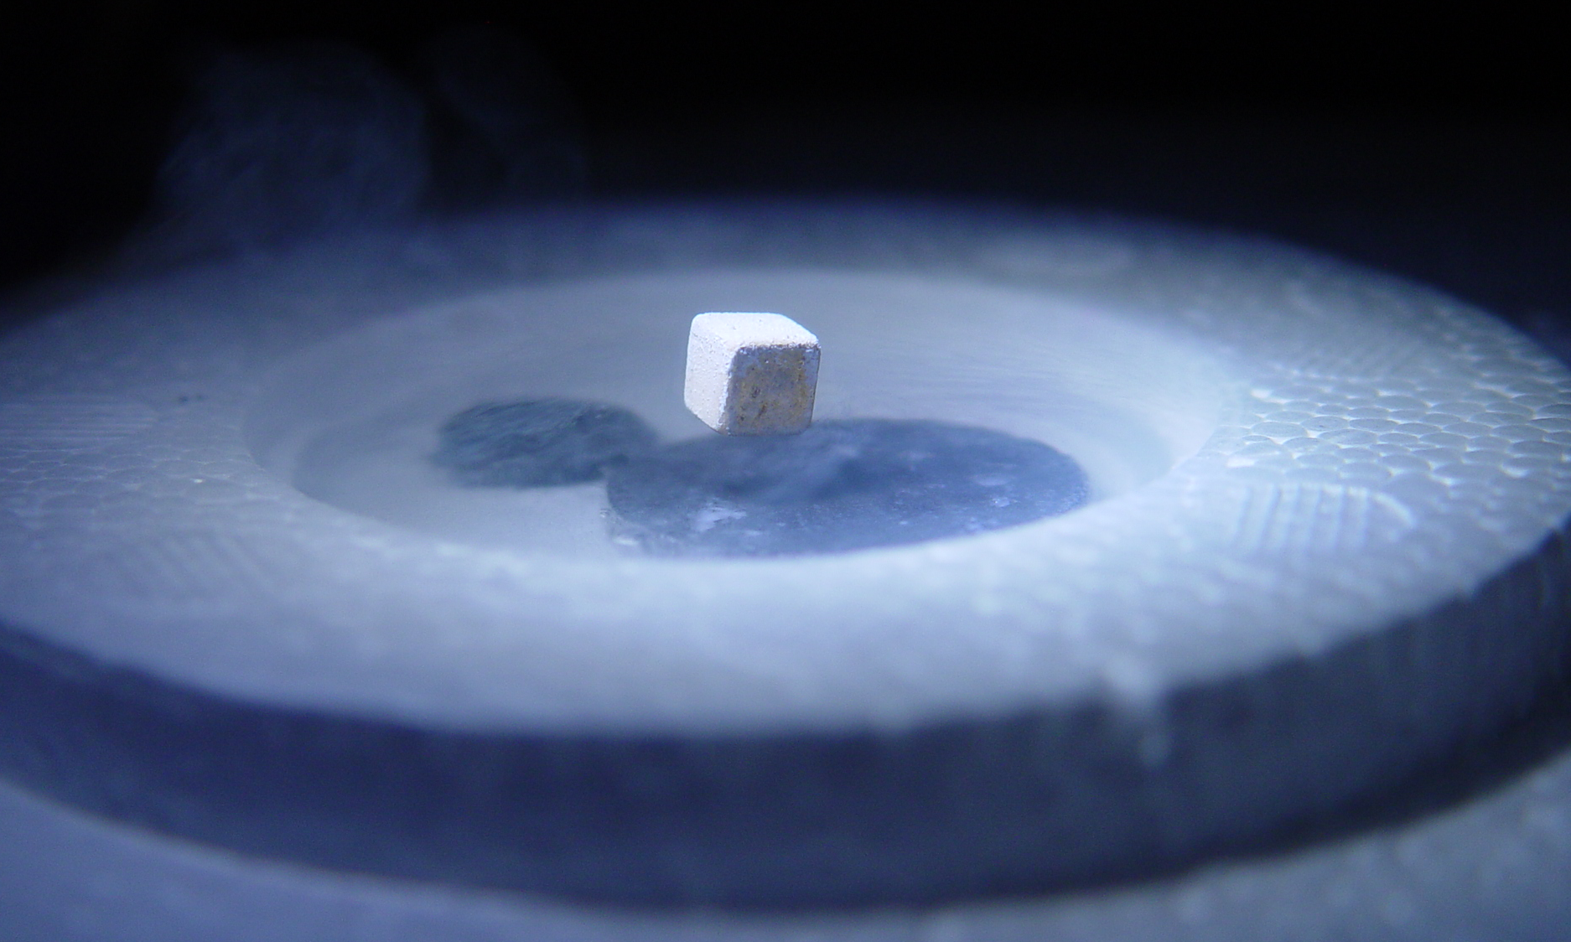
Mesoscopic Transport in High Temperature Superconductors Jordan Pommerenck †
† Oregon State University Department of Physics, Corvallis, Oregon, USA. PH671
Notes:
Title Page:

Slide 2
An Outline of Electron Transport in HTS
Brief Introduction to BCS and Pairon Theory
Type I vs II Superconductors
The Seebeck Effect in HTS
HTS Applications in Science and Industry
Notes:
Title Page:

Slide 3
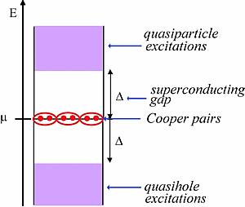
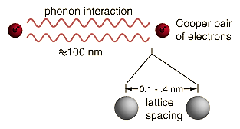
Brief Introduction to Cooper Pairs (Pairons) and the BCS Theory Result
In the 1950s, Bardeen, Cooper, and Schrieffer developed a Hamiltonian Formalism to describe observed superconductor behavior. The famous result relates the energy gap to the critical temperature.
Electrons are bound in Cooper Pairs (Pairons). A Pairon although composed of two electrons (Fermions) is a Boson system.
http://hyperphysics.phy-astr.gsu.edu/hbase/solids/coop.html http://www.cnano-raa.org/spip.php?article77
Notes:
Title Page:

Slide 4
Brief Introduction to BCS Theory Result
Around the same time, Cooper and Schrieffer developed another independent method continuing to use the concept of Pairons to calculate the critical temperature in 2D and 3D.
The zero temperature BCS coherence length helps to determine the Pairon size.
Theory of High Temperature Superconductivity by S. Fujita et al.
Notes:
Title Page:

Slide 5
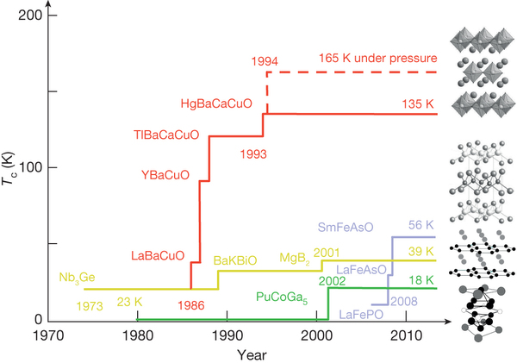
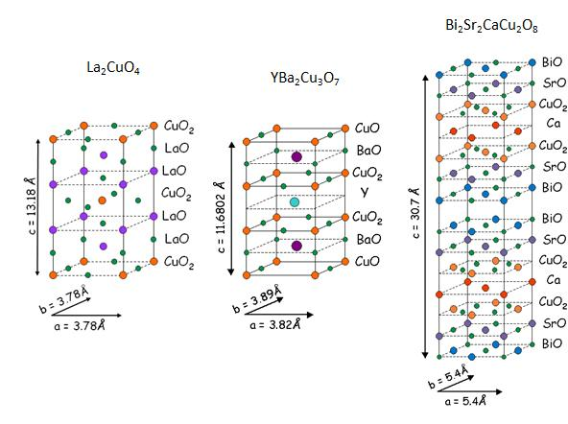
Example using what has been learned
Among the first HTS to be discovered was YBCO. The coherence length is different for along the crystal axis but is given along the a and b unit axis as .
Find the 2D Pairon density and Fermi velocity for Yttrium Barium Copper Oxide (YBCO).
B. Keimer et al. doi:10.1038/nature14165 www.phys.ufl.edu
Notes:
Title Page:

Slide 6
An Outline of Electron Transport in HTS
Brief Introduction to BCS and Pairon Theory
Type I vs II Superconductors
The Seebeck Effect in HTS
HTS Applications in Science and Industry
Notes:
Title Page:

Slide 7
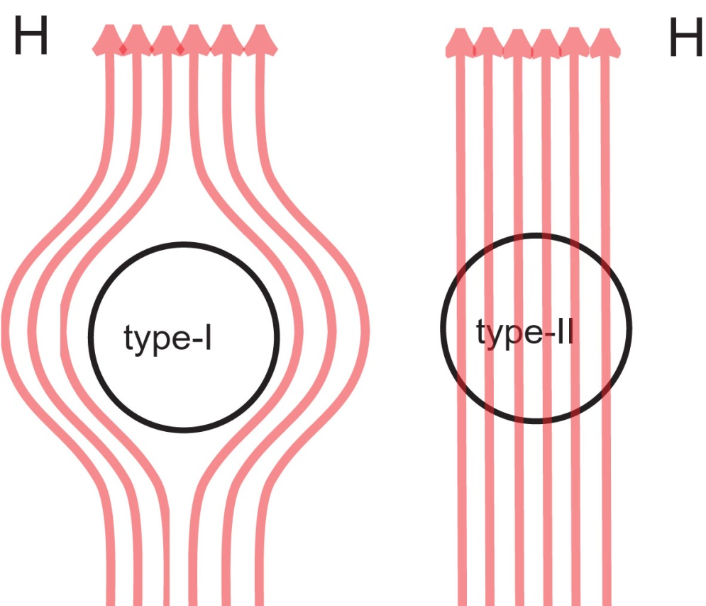
Type I vs. Type II Superconductors
Compound superconductors have type II magnetic behavior, that is, they form magnetic vortices below a critical temperature. Type II allows partial penetration of magnetic field below the critical temperature while a type I repels the field.
http://www.nobelprize.org/nobel_prizes/physics/laureates/2003/popular.html
Notes:
Title Page:

Slide 8
Coherence Length and London Penetration Depth
The coherence length and the London penetration depth determine whether the superconductor is type I or II.
The London penetration depth can be determined by definition to be the distance in which the magnetic field becomes weaker by a factor 1/e.
Notes:
Title Page:

Slide 9
Example using what has been learned
For high temperature cuprate superconductors such as
the Fermi velocity and number densities are on the order:
We can also find the temperature using Cuprate High Temperature Superconductors by Hott et al. which gives us
Physical Properties of High-Temperature Superconductors (pg. 231) by Rainer Wesche
Notes:
Title Page:

Slide 10
An Outline of Electron Transport in HTS
Brief Introduction to BCS and Pairon Theory
Type I vs II Superconductors
The Seebeck Effect in HTS
HTS Applications in Science and Industry
Notes:
Title Page:

Slide 11
An Introduction to the Seebeck effect in HTS
The Seebeck Coefficient (thermopower) depends on the properties of the material. For a metal rod, we can classically write the following:
With a thermal gradient between the ends of the rod, no current will flow. We can now define the Seebeck Coefficient.
Both the classical and Semi-Quantum heat capacities can be related to the Seebeck Coefficient.
N.W. Ashcroft and N.D. Mermin, Solid State Physics (Holt, Rinehart and Winston, New York, 1976).
Notes:
Title Page:

Slide 12
Full quantum treatment of the Seebeck effect in HTS
The classical and even semi-quantum theory introduced so far made assumptions about the Fermi degeneracy and chemical potential being independent of temperature. Also, the sign cannot account for positive Seebeck coefficients. Now we consider a full quantum treatment.
Theory of High Temperature Superconductivity by S. Fujita et al.
Notes:
Title Page:

Slide 13
Example using what has been learned
What is the Seebeck Coefficient for a typical HTS cuprate? From the literature, the Fermi energy is at most 100 meV, and the Seebeck Coefficient is on the order of 3 – 35 depending on doping.
(Physical Properties of High-Temperature Superconductors by Rainer Wesche)
Remember that the Seebeck Coefficient is relative to Platinum
Studies of High Temperature Superconductors (vol. 35 pg. 24) by Anant Narlikar
Notes:
Title Page:

Slide 14
An Outline of Electron Transport in HTS
Brief Introduction to BCS and Pairon Theory
Type I vs II Superconductors
The Seebeck Effect in HTS
HTS Applications in Science and Industry
Notes:
Title Page:

Slide 15
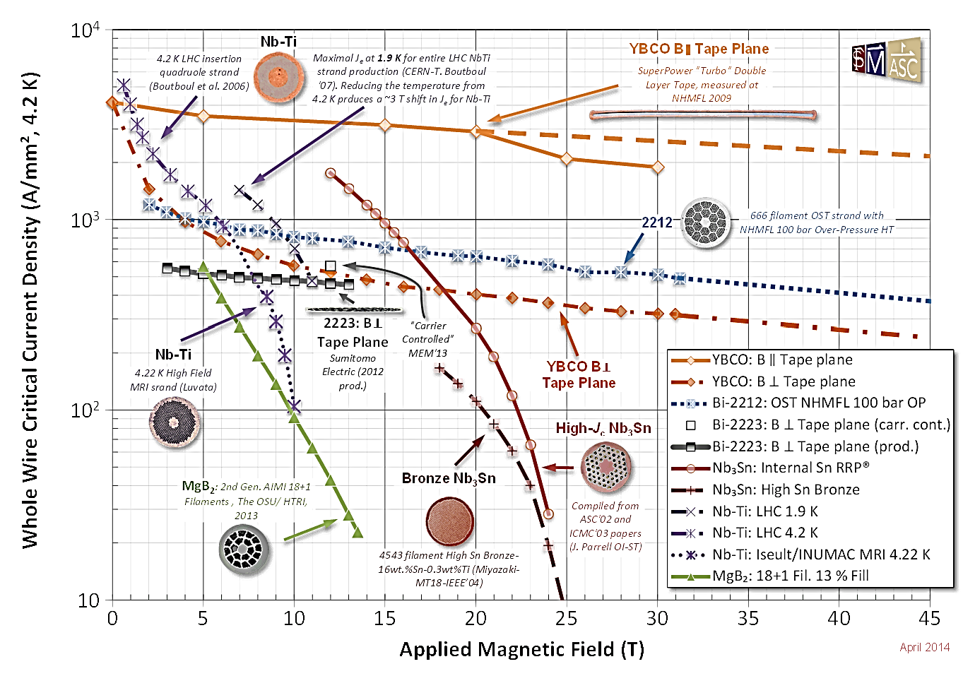
High Temperature Superconductivity in plasma fusion: Comparison
https://nationalmaglab.org/magnet-development/applied-superconductivity-center/plots
Notes:
Title Page:

Slide 16
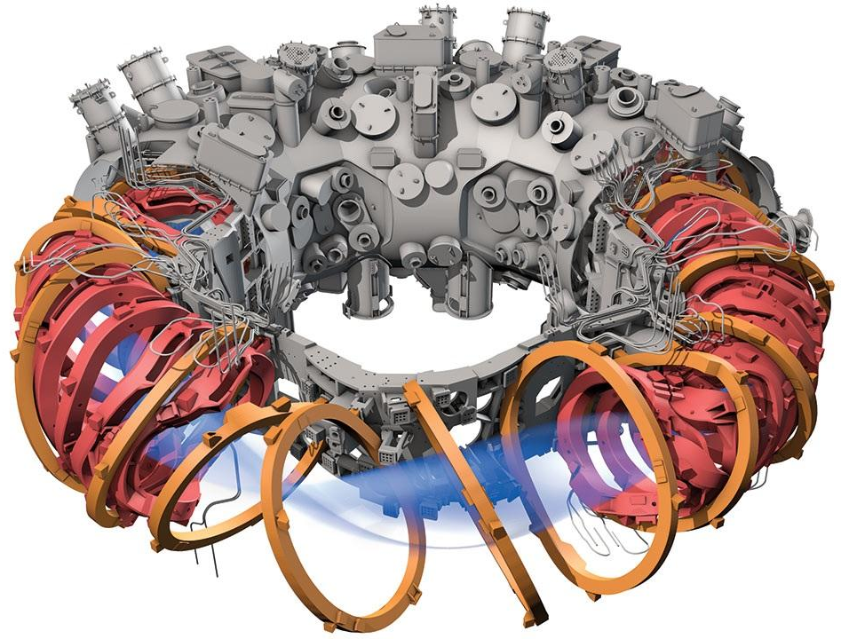
High Temperature Superconductivity in plasma fusion: Wendelstein-7X
Clery, Daniel. "Twisted logic." Science 350.6259 (2015): 369-371.
Notes:
Title Page:

Slide 17
Conclusion on High Temperature Superconductivity
What Have We Learned?
We have learned about the important results of BCS and Pairon Theory
We have learned how to determine whether a material is a Type I or II Superconductor
We have learned how to calculate the Seebeck Coefficient for HTS materials
We have learned about a HTS application in plasma physics
Thank You!
Are there any Questions?
Notes:
Title Page:

